Slide 1
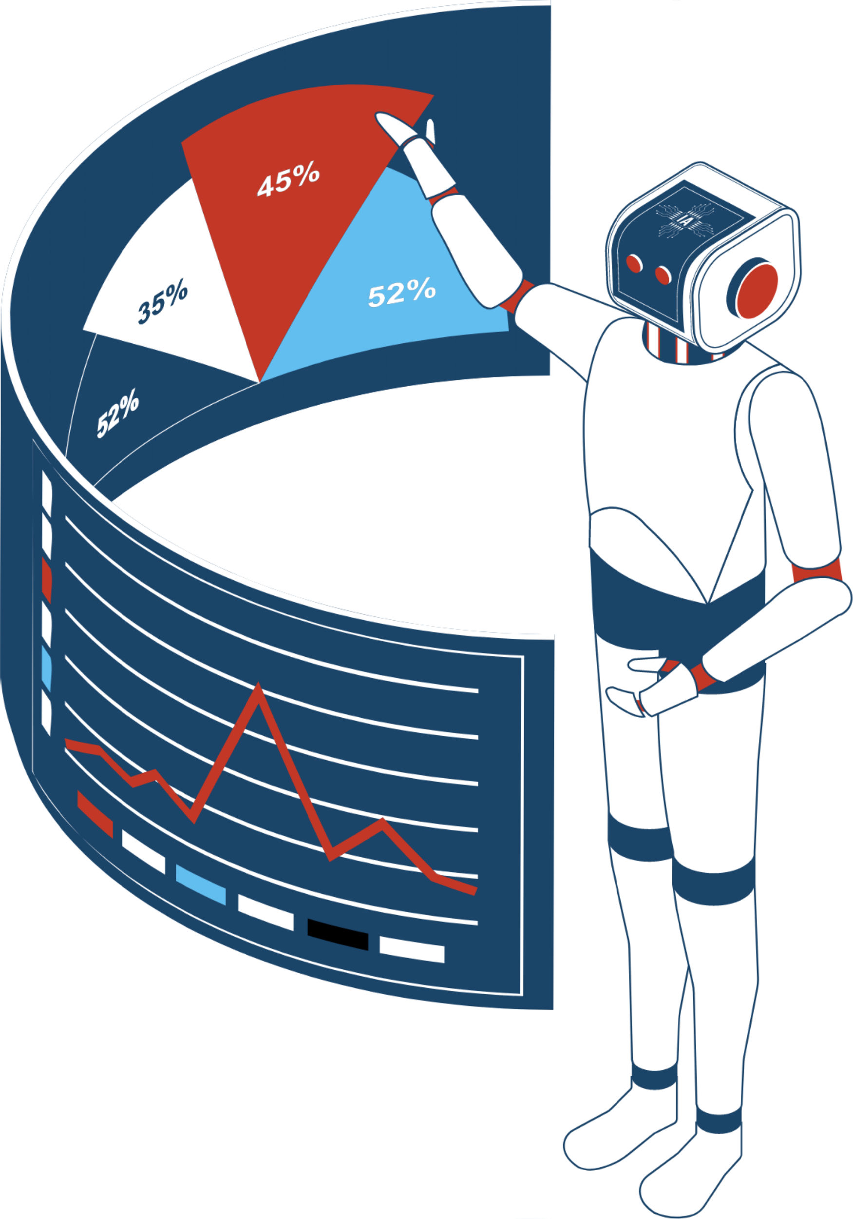
Placement prediction WebApp Using
Python & Machine Learning

Slide 2


Abstract:
An educational institution has one of the most important objectives that is placement of a student. Educational institutions are always working for the placement of student by introducing new courses and skills. The analytical study of the skills of student, both technical and soft skills give idea about the student will be placed or not. This model will give idea about the skill to be prepared for the placement
The proposed model predicts whether the student will place or not. It uses technical and soft skills. In this project the previous year student’s data is used to predict the chance of student placement. The bult model is based on the decision tree classification algorithm. This classification model classifies the student into the placed or not placed category.
This classification model will help the student to check their progress easily from time to time. Parameters used for the prediction are the academic score, internship done or not, total number of backlogs etc. The proposed model is also compared with the other classification model with their accuracy. The accuracy obtained from this model is 85%. The model also helps in analysis of difference between skillset of placed and not placed student.
Keywords: Machine learning, Decision tree algorithm, python flask

Slide 3
INTRODUCTION:
Purpose:
Scope:
To study the machine learning algorithms and implantation of same for the prediction of the student. The model built using decision tree algorithm able to predict the placement of student based on previous year student data. Help students to improve their skillset from time to time. Compare Built model’s accuracy with already existing models for placement prediction to understand efficiency of the algorithm used.
The project is based on the decision tree classification algorithm in machine learning. It involves the study and comparison between the different machine learning algorithms. The model also able to study the analysis of student skillset require for placement.

Slide 4


Objectives:
To study the decision tree algorithm.
To implement decision tree algorithm for placement prediction.
To compare the performance of decision tree algorithm with other machine learning algorithms to understand efficiency of algorithms.

Slide 5



ABBREVIATIONS USED:
01
CSS – Cascading Style Sheets
02
HTML- Hyper Text Markup Language.
03
ML- Machine Learning
04
REST- Representational State Transfer.
05
API- Application Programming Interface
SVM- Support Vector Machine
06
07
KNN- K-Nearest Neighbours
08
XGBoost- Extreme Gradient boosting

Slide 6


SYSTEM ANALYSIS
- Gender: Categorical (e.g., Male, Female)
- Stream: Categorical (e.g., Engineering, Commerce, Science)
- Internship: Binary (0 or 1 indicating no or yes, respectively)
- CGPA: Continuous numerical
- Backlogs: Discrete numerical (number of backlogs)
INPUT
OUTPUT
Prediction of placement outcome: High chances or low chances

Slide 7


SYSTEM REQUIREMENTS
Hardware Requirements:
PC with the configuration as Pentium IV 1.7 GHz. 128M.B RAM, 40 G.B HDD, 15” Color
Adequate storage space for storing the application code, trained model, and any associated data files
Monitor, Keyboard, Mouse

Slide 8





Software Requirements:
Python 3.x: Required for running the Flask web application and machine learning model
Flask: Web framework for building the user interface and handling HTTP requests.
NumPy: Library for numerical computations, used for data manipulation
pandas: Library for data manipulation and analysis, used for loading and preprocessing data
scikit-learn: Library for machine learning algorithms and tools, used for training and using the prediction model
Web browser: Users need a modern web browser to access the web interface

Slide 9








SOFTWARE SPECIFICATIONS:
Flask Web Application
Machine Learning Model
Data Storage
Development Environment
Deployment Environment

Slide 10

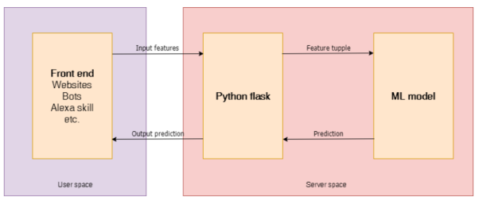
SYSTEM ARCHITECTURE AND DESIGN

Slide 11
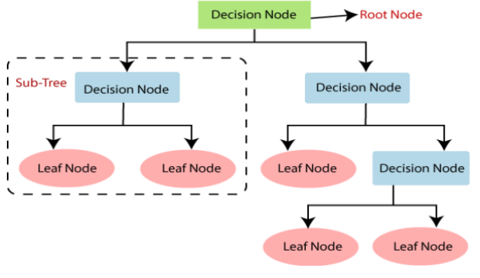
Algorithms

Slide 12




SYSTEM TESTING
Unit Testing
Integration Testing
Functional Testing
Performance Testing
Security Testing
Usability Testing
Regression Testing
Deployment Testing

Slide 13
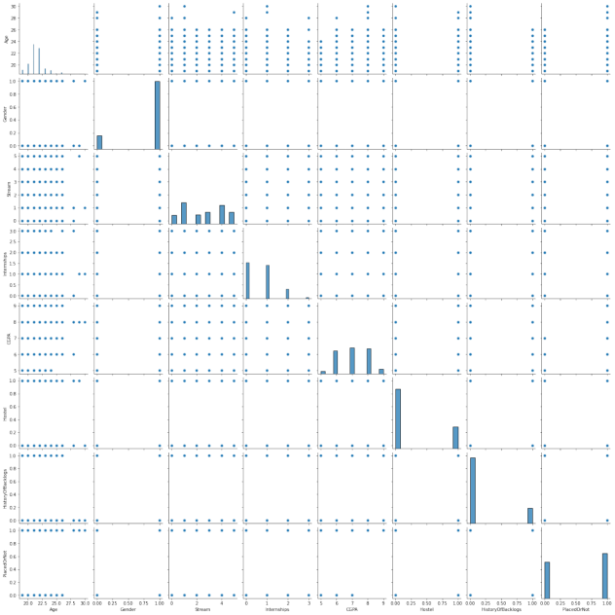
RESULTS
Dataset Interpretation
( Correlation graph )

Slide 14
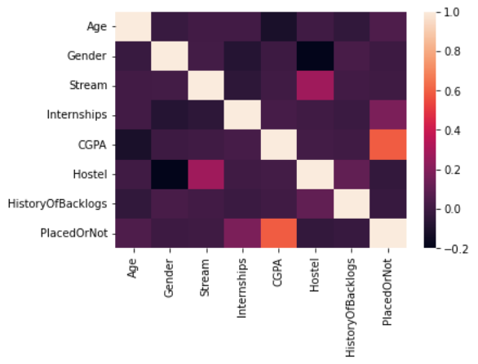
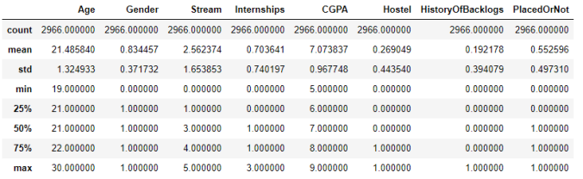
Correlation heatmap
Dataset Description

Slide 15

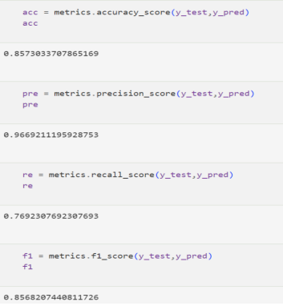
Model accuracy
( The model showed 85.7% accuracy, 96.6% precision, 76.9% recall and 85.7% F1 score )

Slide 16


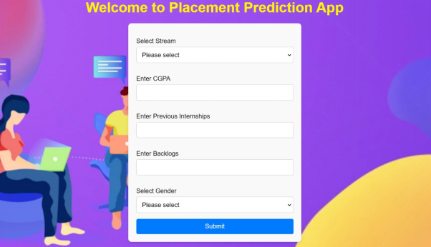

Webapp results
Final web page
Webpage Interface
Result Page

Slide 17



CONCLUSION
The campus placement process holds immense significance for both educational institutions and students, serving as a critical juncture that defines the future trajectories of individuals and reflects the effectiveness of academic programs. This project endeavours to enhance the performance and opportunities for students by leveraging advanced analytical techniques, specifically classification algorithms like Decision Trees, to analyse and forecast placement outcomes.

Slide 18


THANK YOU !

